Slide 1
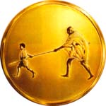
Value Added Course MGM BLS
Mahatma Gandhi Mission
MGM SKILLS LAB

Slide 2
AMERICAN COLLEGE OF SURGEONS AND ATLS(I) ACCREDIATED ATLS & ATCN

Slide 3
CHILD AND INFANT BLS

Slide 4
Infants are less than 1 year of age (excluding the newborn)
Children are from 1 year of age to puberty. Signs of puberty include chest or underarm hair on males and any breast development in females.

Slide 5
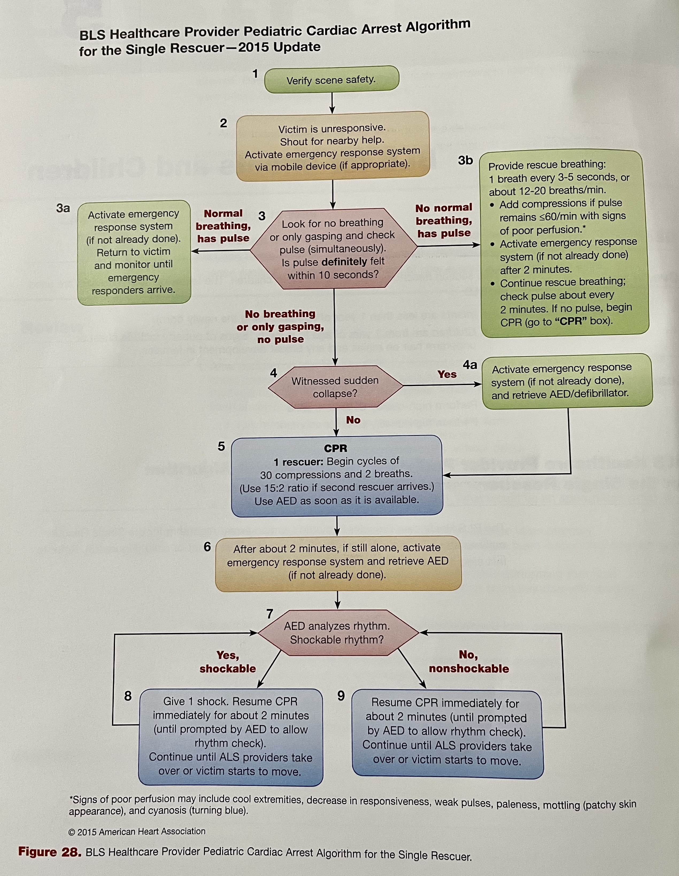

Slide 6
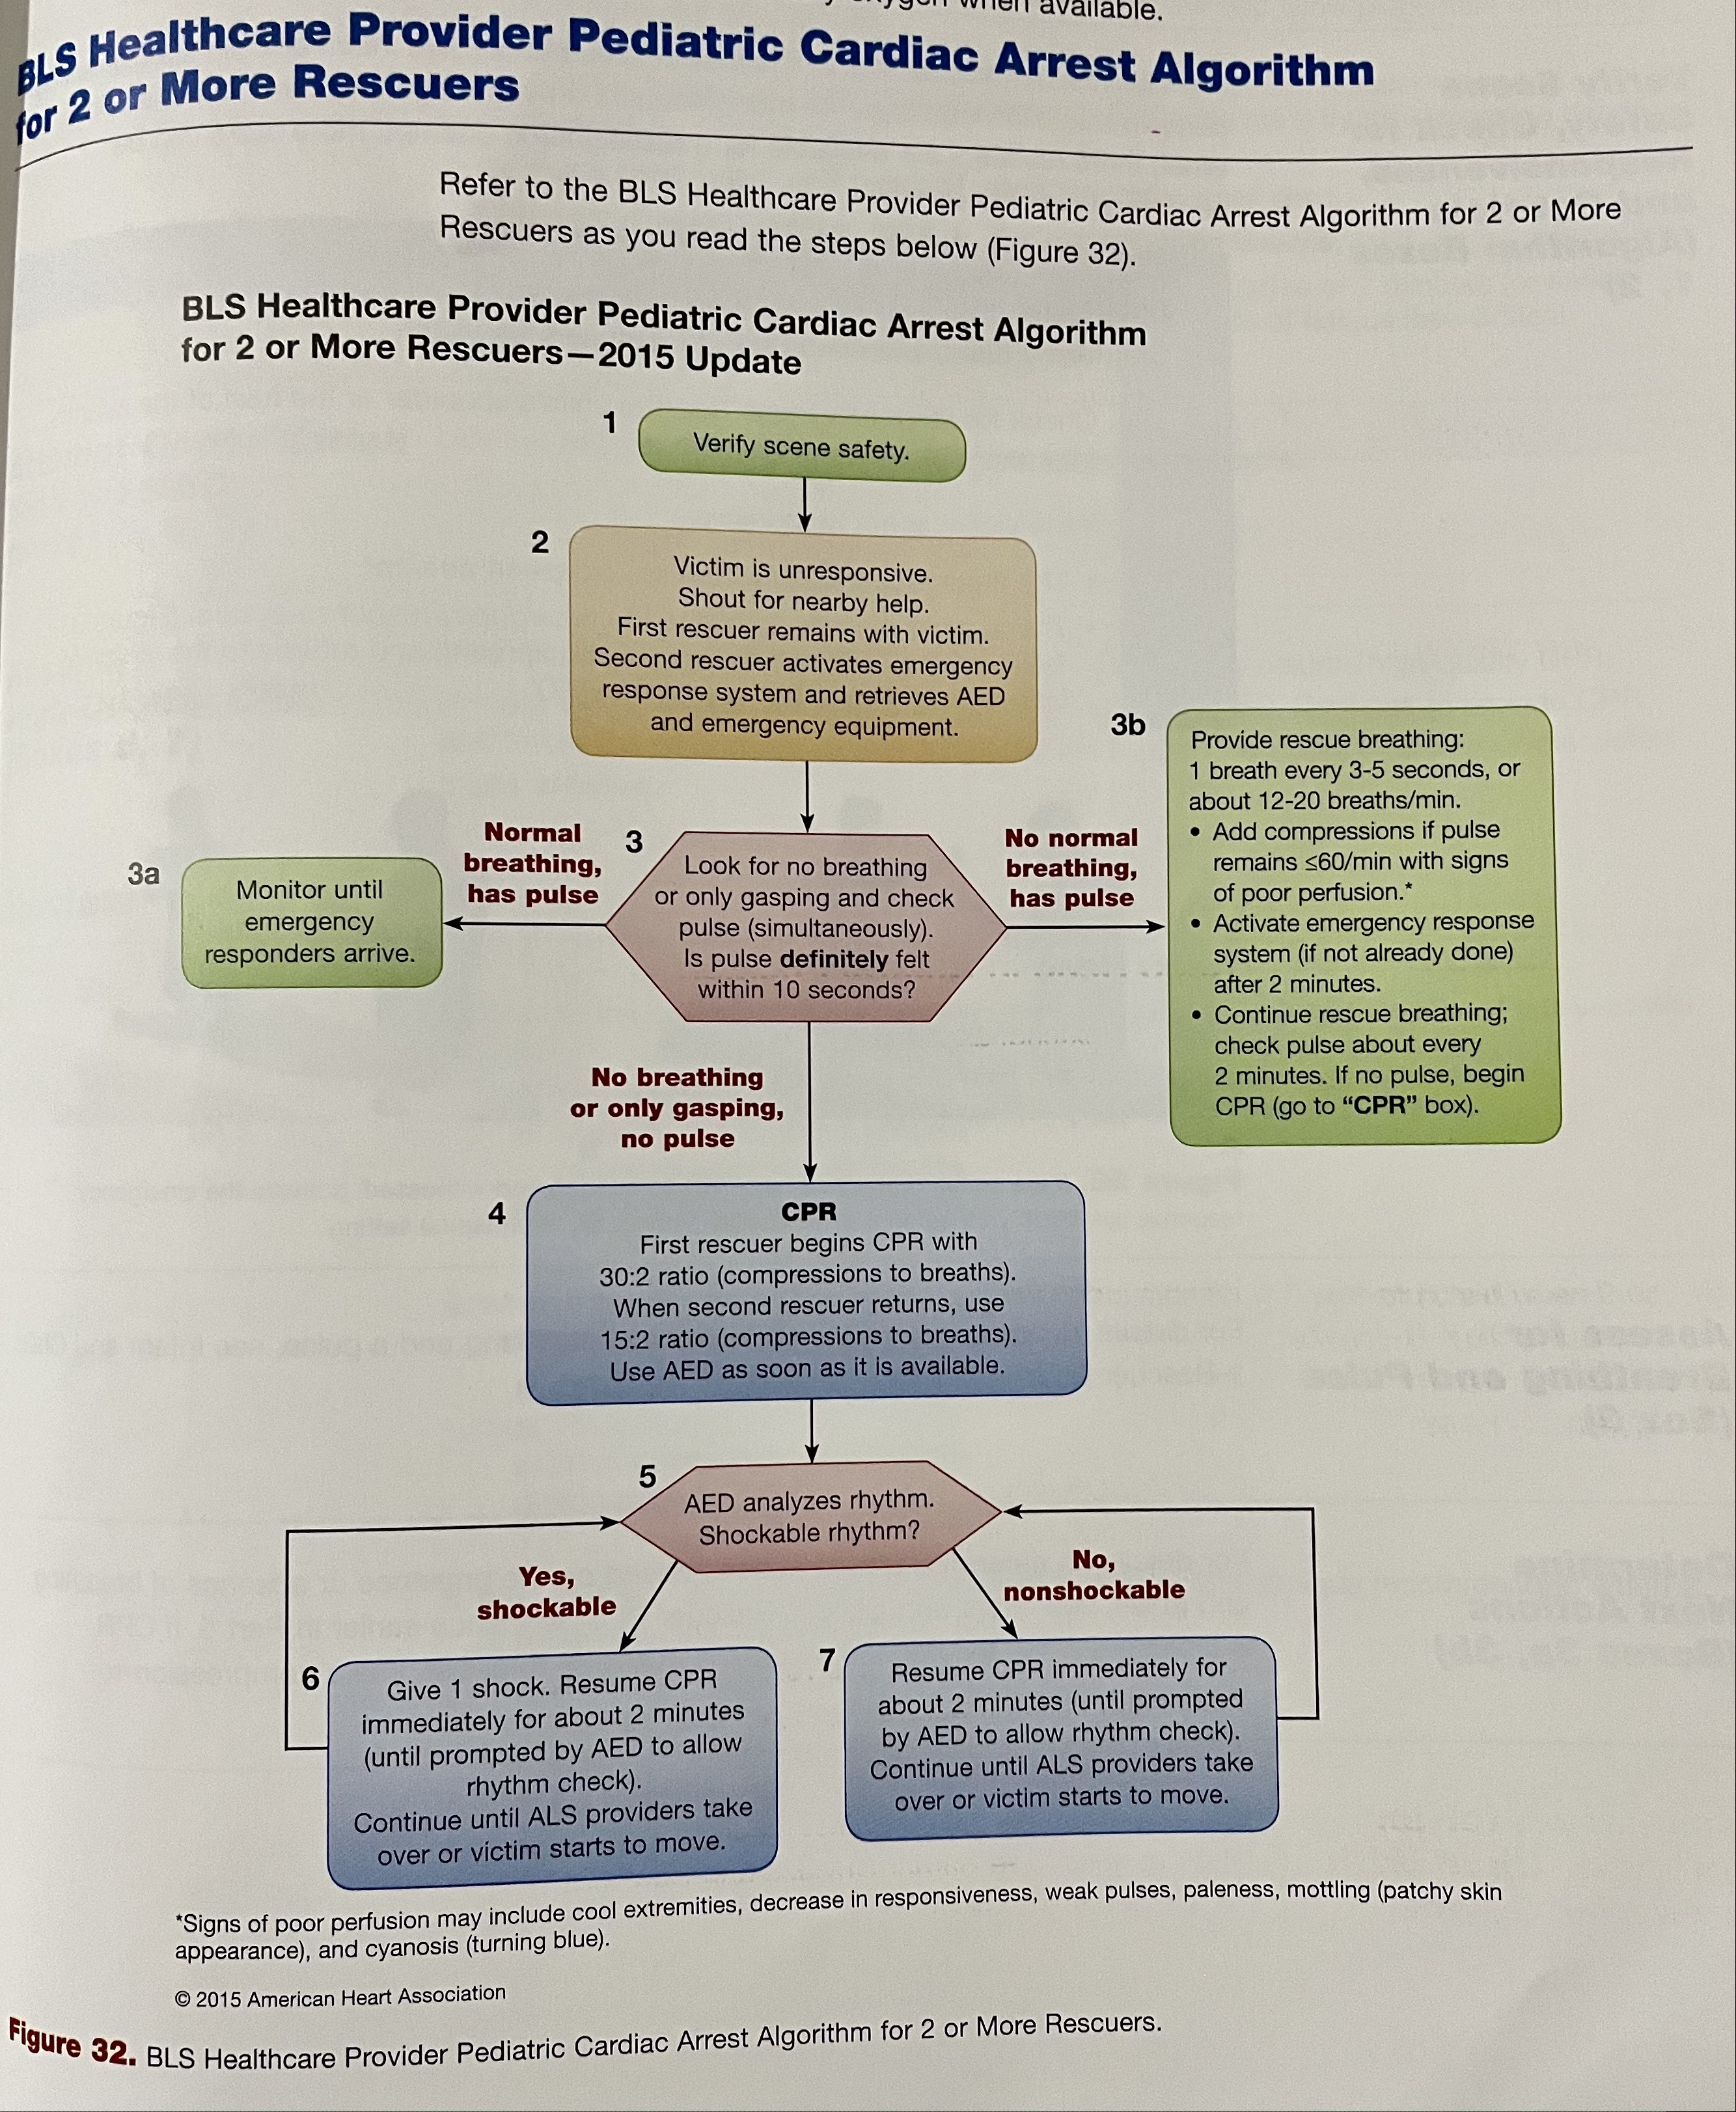

Slide 7
CHECK PULSE
Infant – Palpate brachial pulse
Child – Palpate a carotid or femoral pulse
To locate brachial artery, place 2 or 3 fingers on the inside of the upper arm, midway between infant’s elbow and shoulder.
To locate femoral artery, place 2 fingers in inner thigh, midway between the hip bone and the pubic bone and just below the crease where leg meets the torso.

Slide 8
INFANT/CHILD CHEST COMPRESSIONS
The universal rate of compressions in all cardiac arrest victims is 100 to 120/min.
Compression to ventilation ratio for single rescuer is 30:2 in adults children and infants.
For infant and child, if 2 rescuers present then compression to ventilation ratio is 15:2.
SITE OF COMPRESSIONS
2 finger technique: Place 2 fingers in the centre of infant’s chest, just below the nipple line, on the lower half of the breast bone.
2 thumb technique: Place both thumbs side by side in the centre of infants chest, on the lower half of breastbone. Encircle the infants chest and support the infants back with fingers of both hands.

Slide 9
2 thumb encircling technique is recommended because:
It produces better blood supply to heart muscle.
Helps ensure consistent depth and force
May generate higher blood pressure
Compression depth:
Children: at least 1/3rd AP diameter of the chest or about 5cm
Infant: at least 1/3rd AP diameter of the chest or about 4cm

Slide 10
INFANT/ CHILD BREATHS
Keep head in neutral position. If extended beyond this , the infants airway may get blocked.
Infants and children who develop cardiac arrest often have respiratory failure or shock that reduces the oxygen content in blood even before the onset of arrest. Hemce, chest compressions alone are not as effective as compressions and breaths for delivering oxygenated blood to the heart and brain.

Slide 11
THANK YOU

